Slide 1




Slide 2
Overview
When a user plays a song he or she may need a recommendation for another song. But, it is hard to find the songs that are a close match to your preferred song..
This is where our project solves the equation. We have designed a machine learning program that will
Analyse your selected song
Search for the best match possible
Show you the result

Slide 3

Road Map
Data Preparation
Coding
Limitations/Improvements
Demonstration
Q & A

Slide 4

Data Source
Kaggle - Spotify Tracks DB (SpotifyFeatures.csv)

Slide 5
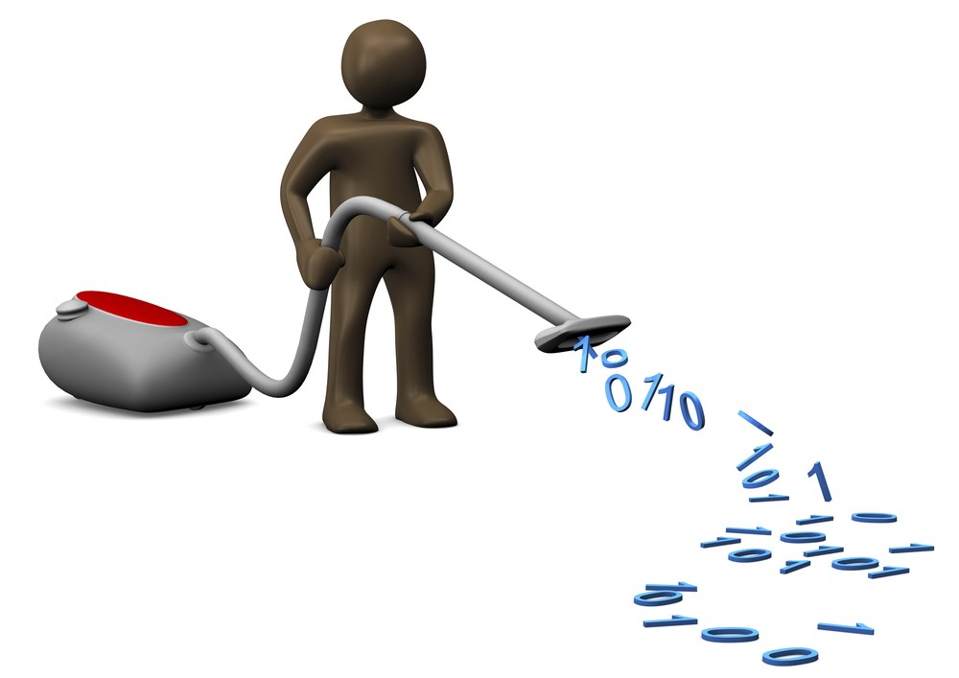
Data Cleaning
Dropna() to remove missing values
Drop_duplicates(subset=[‘track_id’]) to remove duplicated songs
Repl_dict to correct error in the ‘genre’ column that creating an extra genre
Assigned each genre a number so it could be put in a csr_matrix

Slide 6



Libraries Used

Slide 7

k-Nearest Neighbours
Algorithm used: kd_tree
Number of neighbours: 4
Csr_matrix

Slide 8

Web Development
Languages used
HTML basic
CSS
Javascript
Bootstrap
Flask (python)

Slide 9

Visualizations
How does a list of top 10 tracks define its genres and artists.
We made a comparison of Top 10 artists, Top 10 songs and Top 10 Genres
We compared the key features of top 10 tracks and figured out the relation between them

Slide 10
Limitations
Improvements
Randomly assigning numbers to genre may have unintended effects on outcome
Certain songs returned a ValueError for incompatible dimensions in the matrices
Using collaborative filtering and convolutional neural networks on raw audio like Spotify does to generate recommendations

Slide 11

Demonstration

Slide 12

Thank you!
Any Questions?

